Slide 1
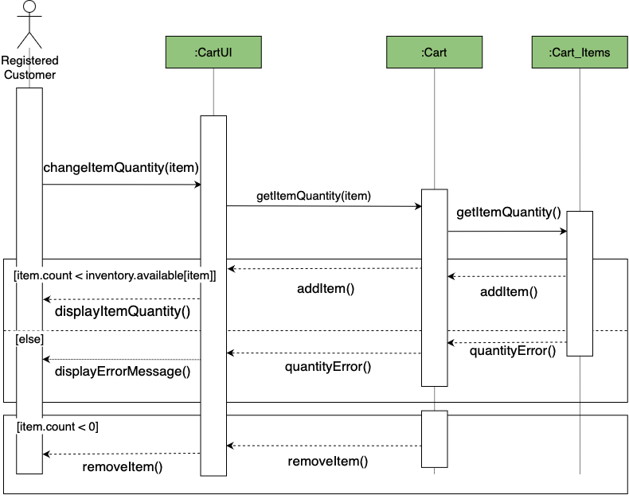
Carriage Sequence Diagram - Team 1
Use Case - 05.02. Manage Orders (make edits)

Slide 2
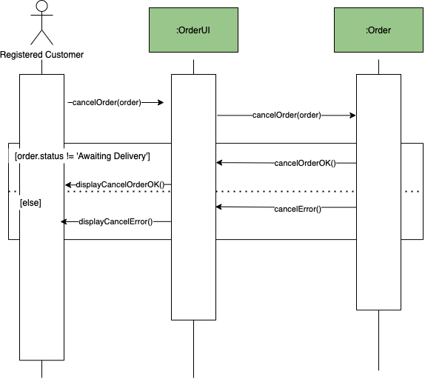
Carriage Sequence Diagram - Team 1
Use Case - 05.03. Cancel Orders

Slide 3
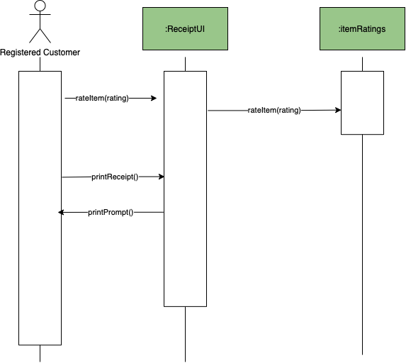
Carriage Sequence Diagram - Team 1
Use Case - 05.07. View Receipt

Slide 4
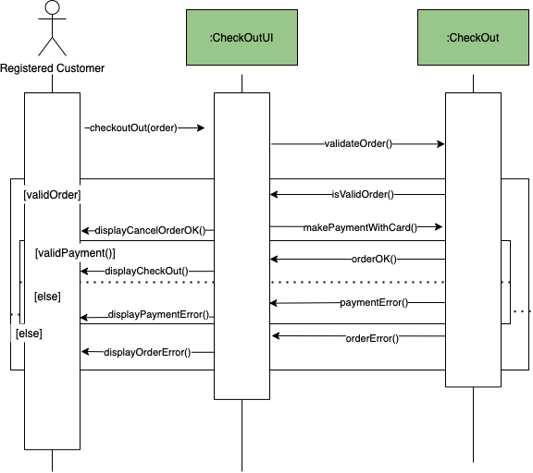
Carriage Sequence Diagram - Team 1
Use Case - 05.08. Checkout Order

